Slide 1
Rally Motors
Nikesh B. and Aviral G.
CAIA Batch DE5

Slide 2
Understanding the Business & Requirements
Rally Motors is a major manufacturer in the automobile sector.
They are present in the Asia-Pacific, America and Europe market areas.
The products sold by Rally are electric cars. A component of these electric cars is software which can be remotely updated.
Rally’s organisation culture is oriented towards customer satisfaction and exceptional, inexpensive service.
Requirements:
Comprehensive data cleansing
Data warehousing & relational management
Generation of reports for “business pain” areas

Slide 3
Data System Analysis
To satisfy the requirements, we started by understanding each table and the data that each table contains.
Source System Analysis is the first analysis document we created. It contains all the details of the tables. We also categorized tables as dimension or fact in this step.
We started tracing the relationships between these tables and recognized the primary key-foreign key relationships.
A data model was created according to our understanding of the table relationships.
We tested join conditions to see if there were any errors while forming relationships.

Slide 4
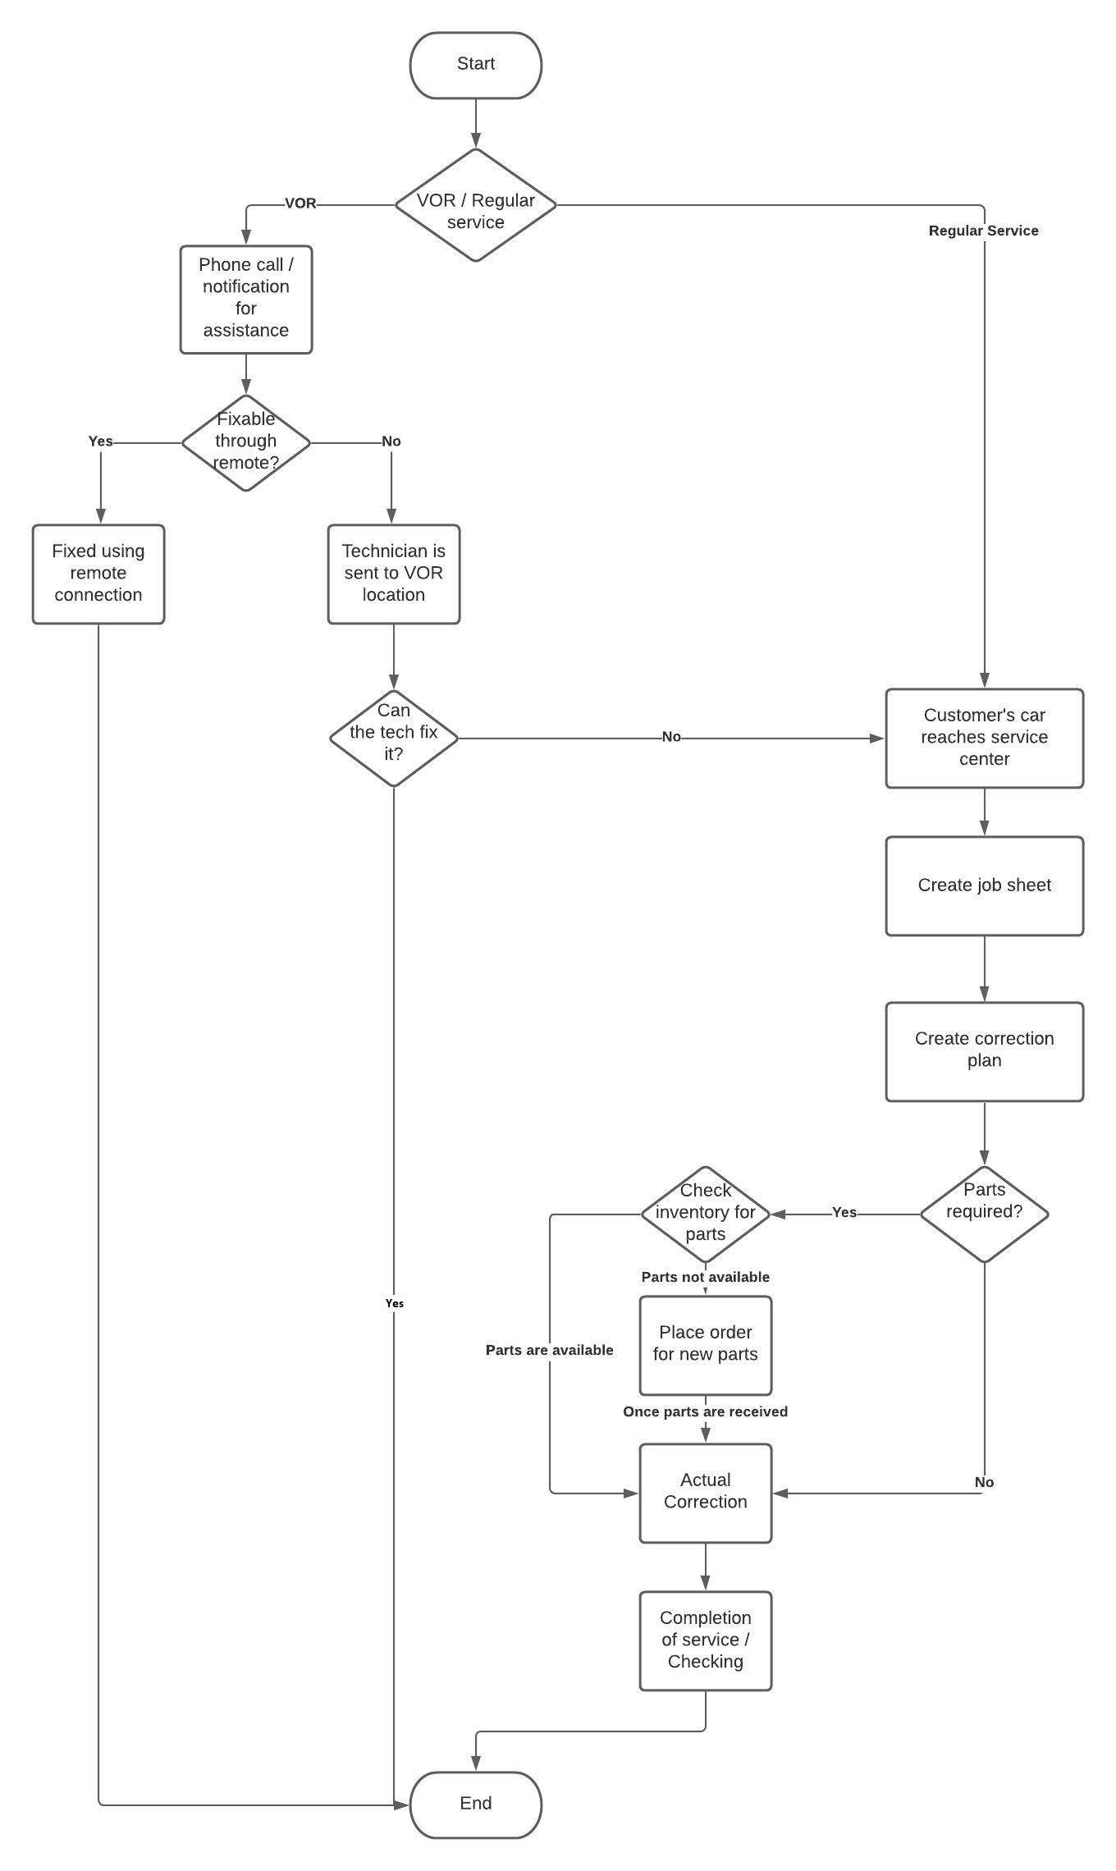
Business Flow Diagram

Slide 5
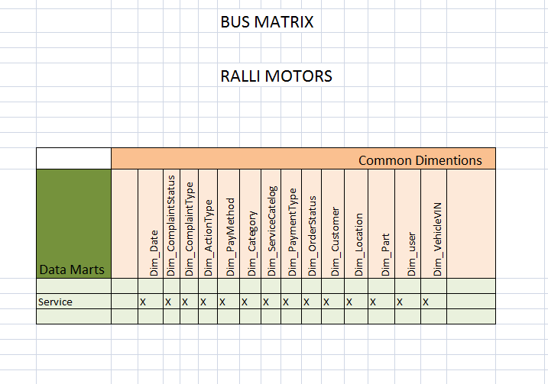
Bus matrix

Slide 6
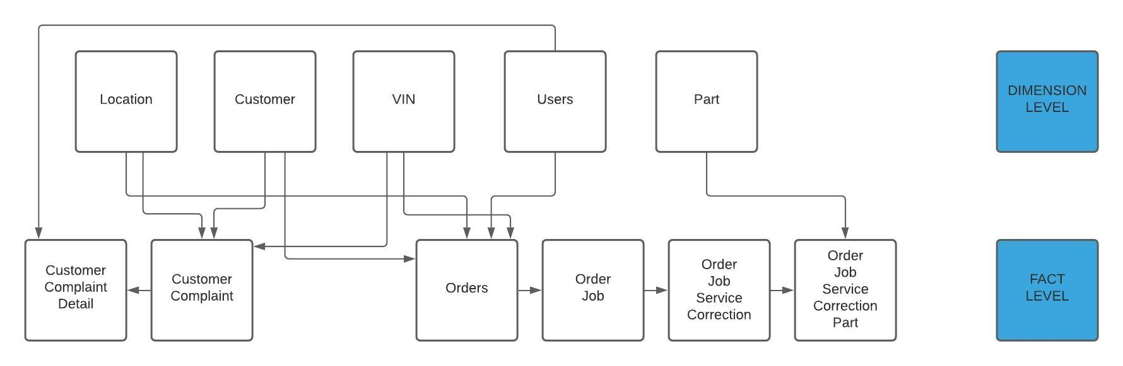
Conceptual Data Model

Slide 7
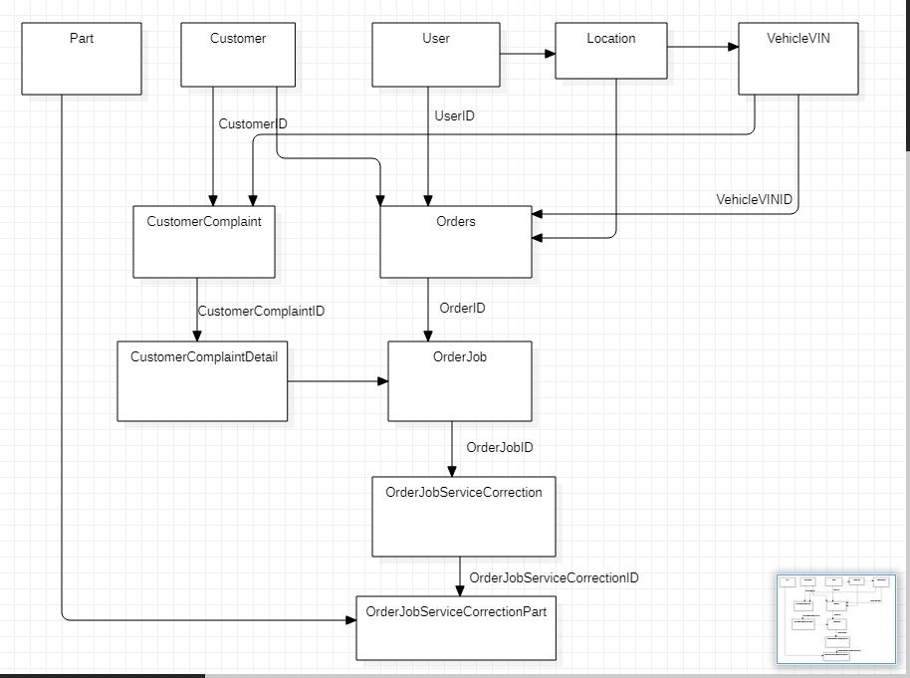
Logical Data Model

Slide 8
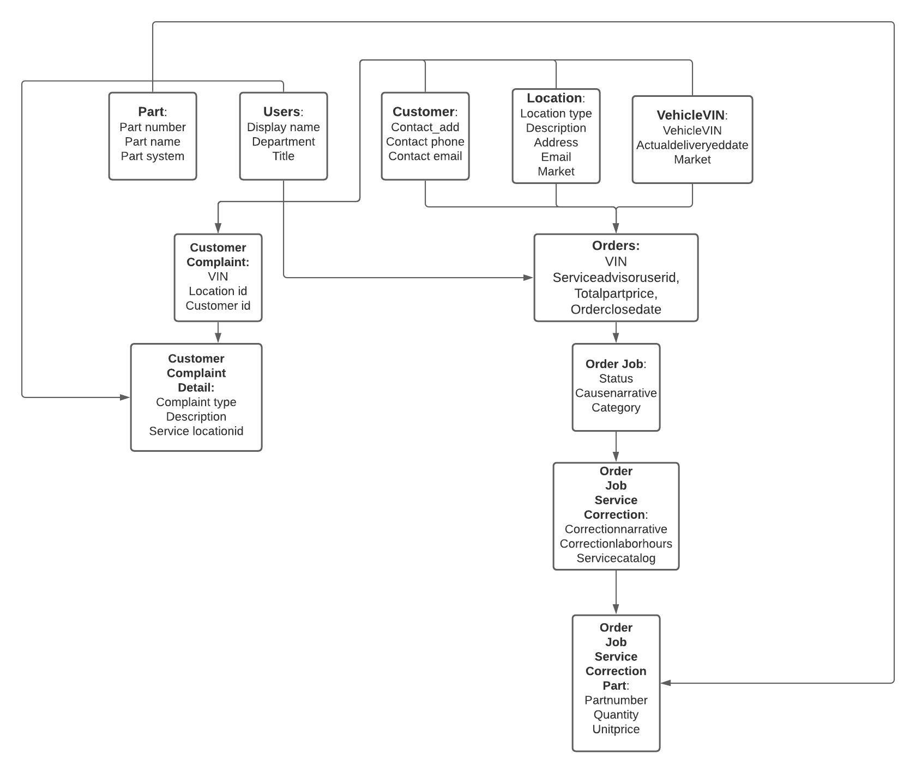
Physical Data Model
PDM - table form
PDM:

Slide 9
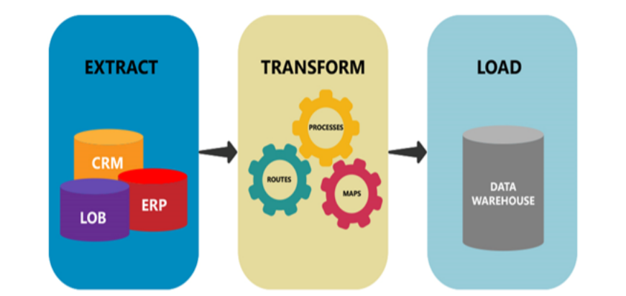
Extract - Transform - Load
We applied our knowledge of ETL processes to Rally’s database system.
Applied SCD1, SCD2, SCD3 or Incremental Load strategy based on the requirements provided.
All operations were performed on Informatica Power Center.
Successfully created the necessary loading structures and tested the same.
We made the necessary transformations and handled null values before completing the load.

Slide 10
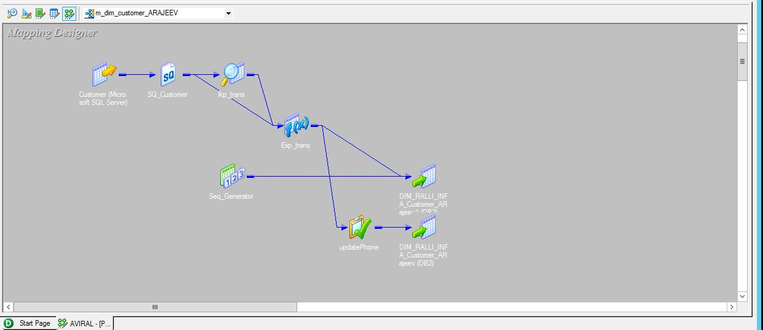
Informatica Power Center - Sample mapping

Slide 11
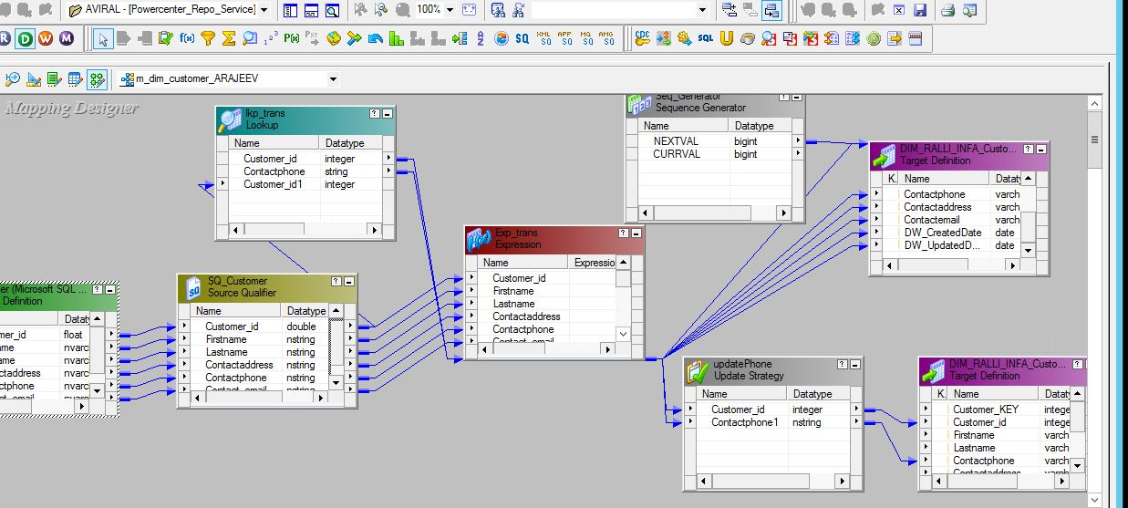
Informatica Power Center - Sample mapping (expanded)

Slide 12
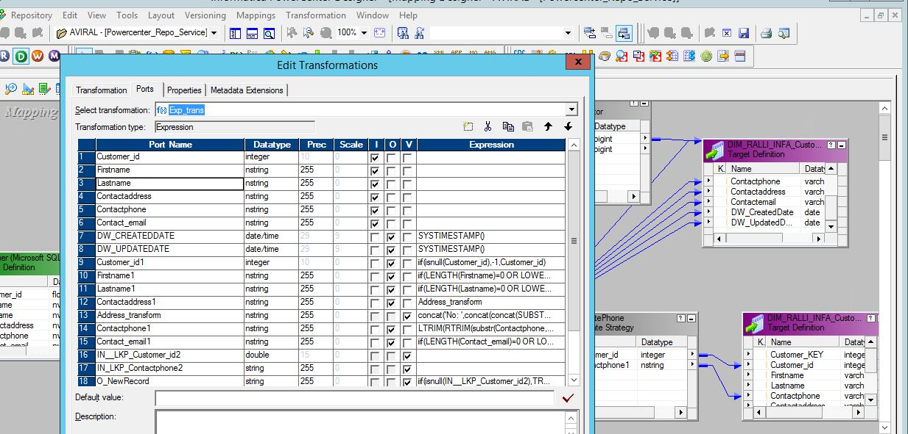
Informatica Power Center - Transformation Sample

Slide 13
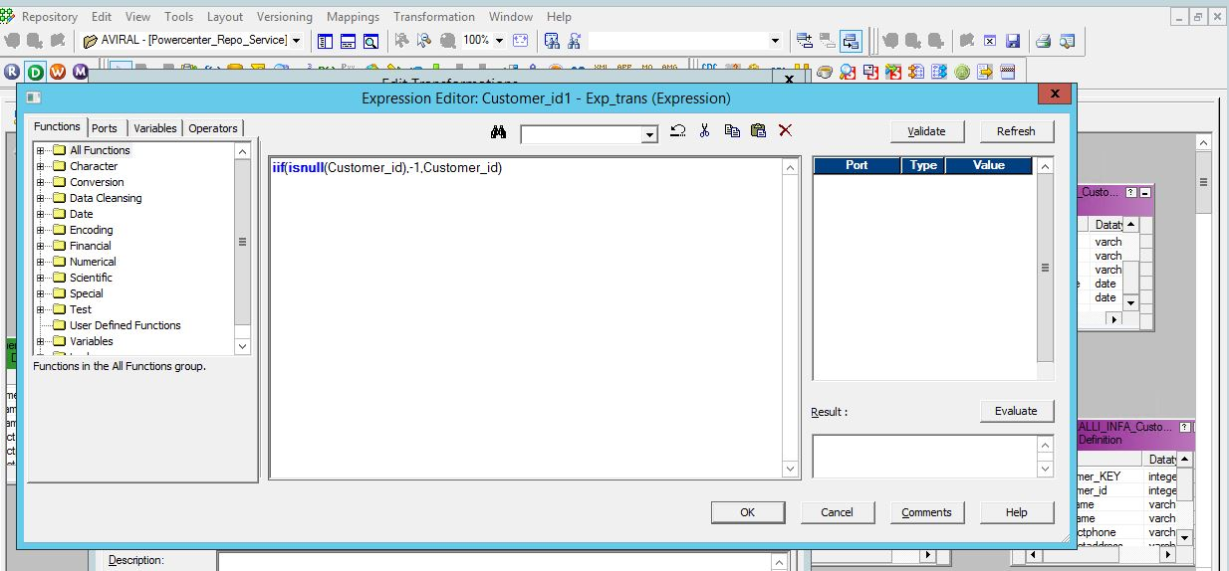
Informatica Power Center - Transformation Edit Sample

Slide 14
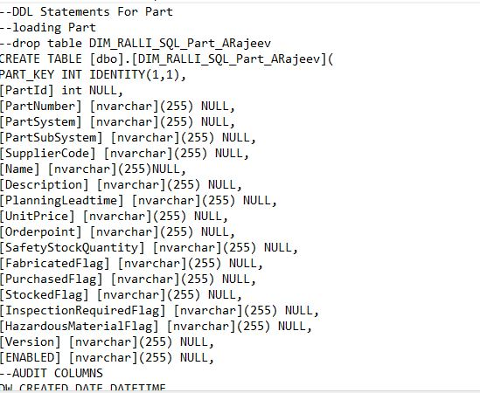
SQL - Data Definition Language

Slide 15
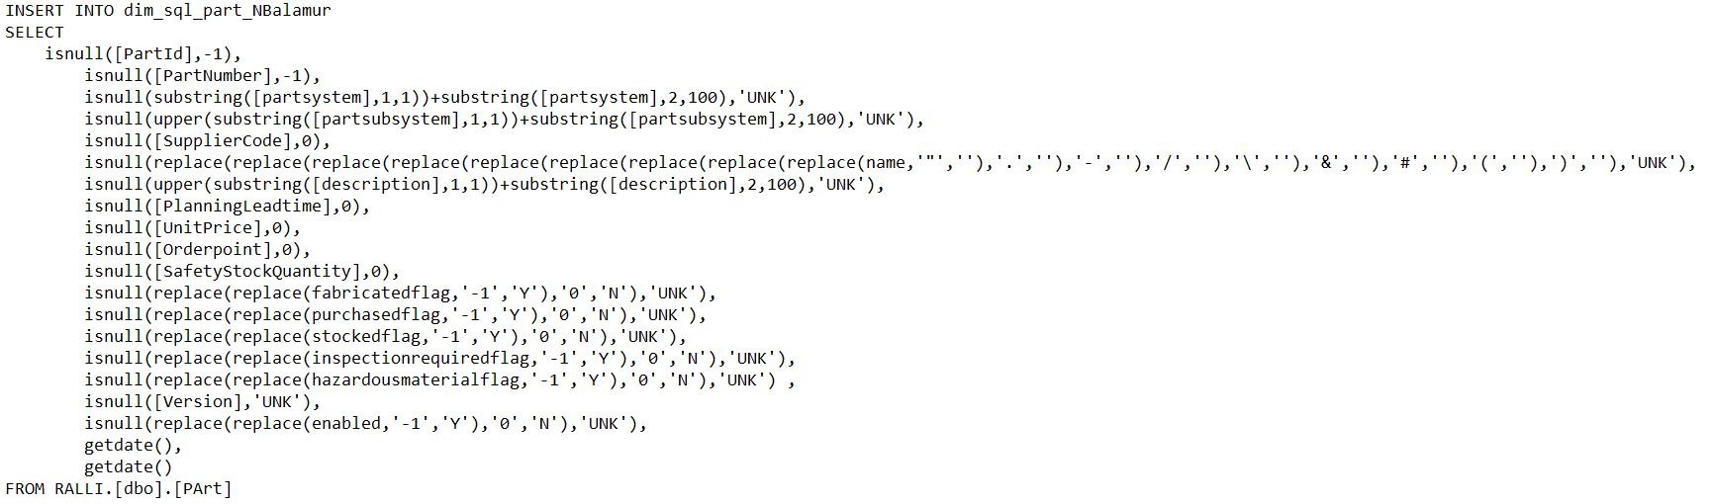
SQL - Data Manipulation Language

Slide 16
Testing
Testing is a crucial part of the process. It helped us understand if the same number of rows are maintained, if there are any discrepancies or errors.
We used multiple tests to check the functionality of our data warehousing.
The results of the these tests were compiled and created.

Slide 17
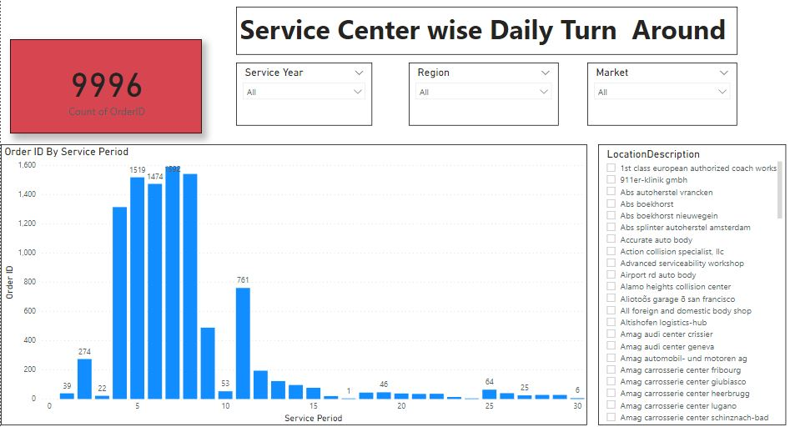
REPORT

Slide 18
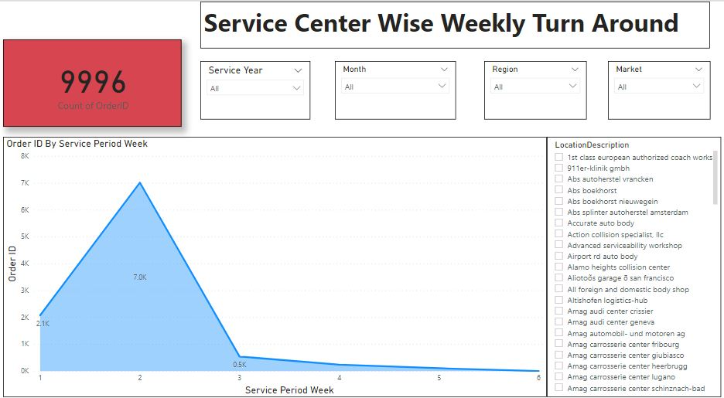
REPORT

Slide 19
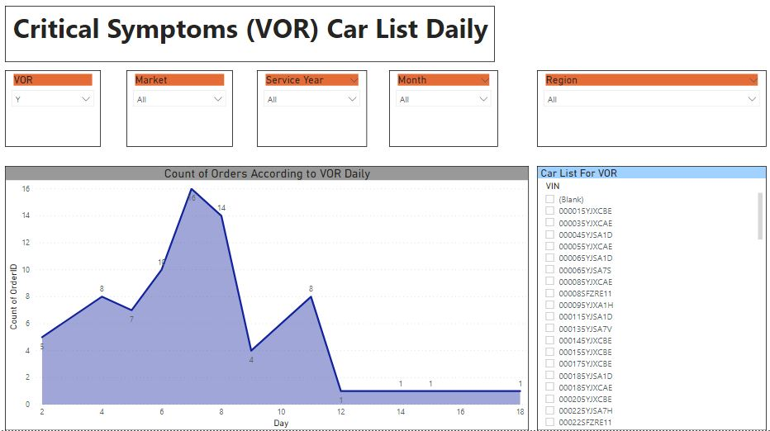
REPORT

Slide 20
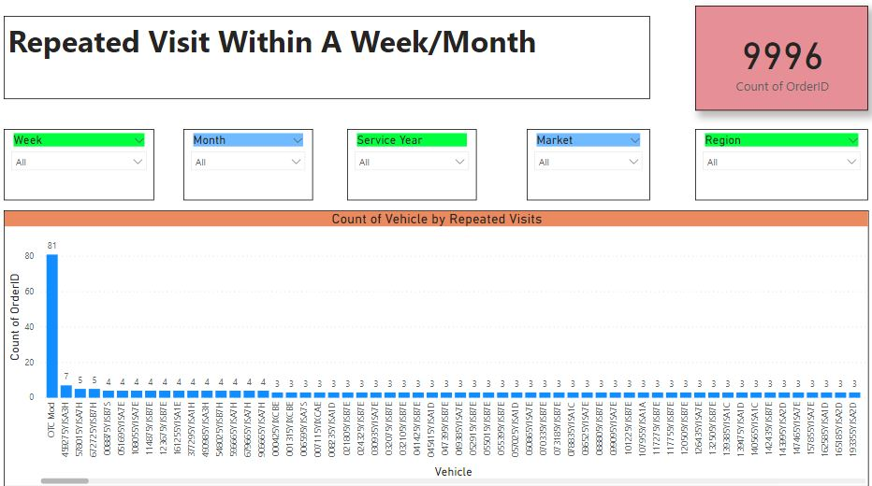
REPORT

Slide 21
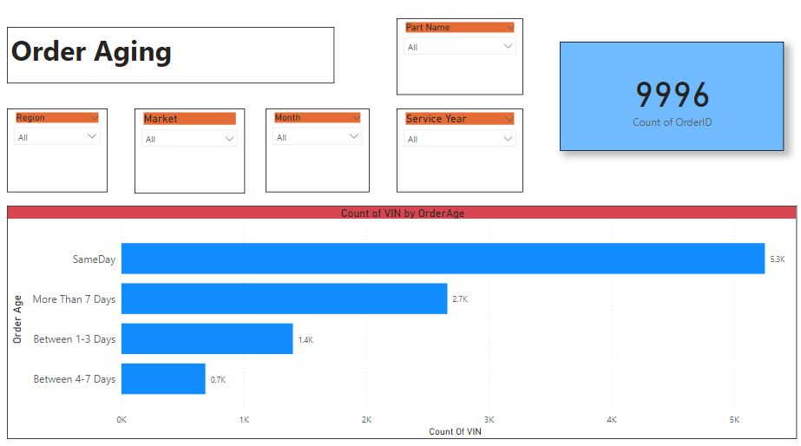
REPORT

Slide 22
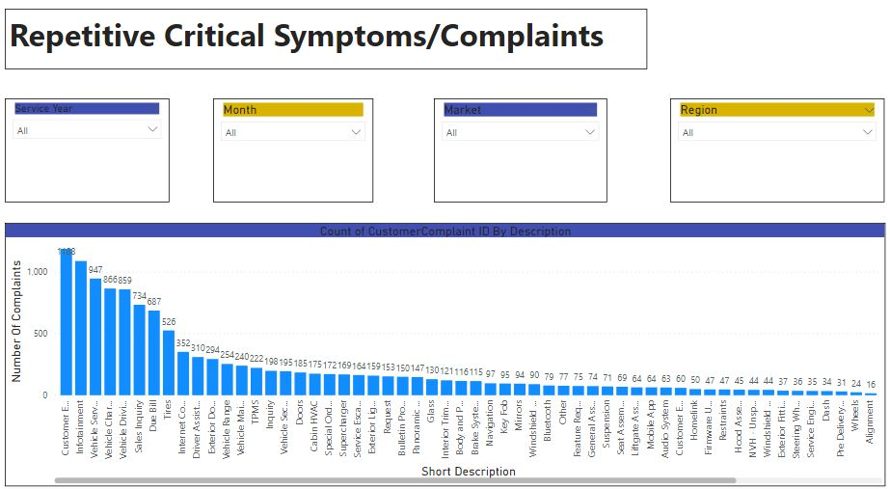
REPORT

Slide 23
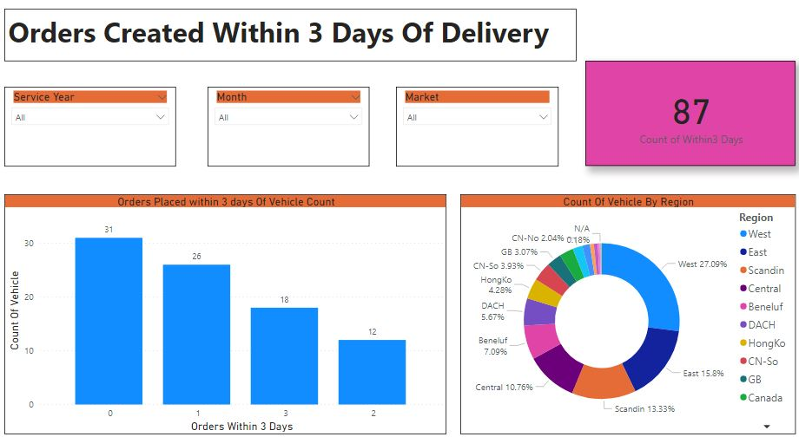
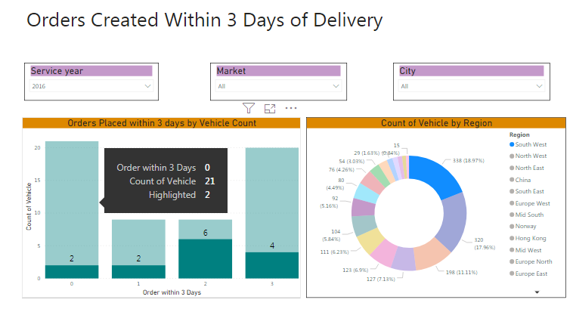
REPORT

Slide 24
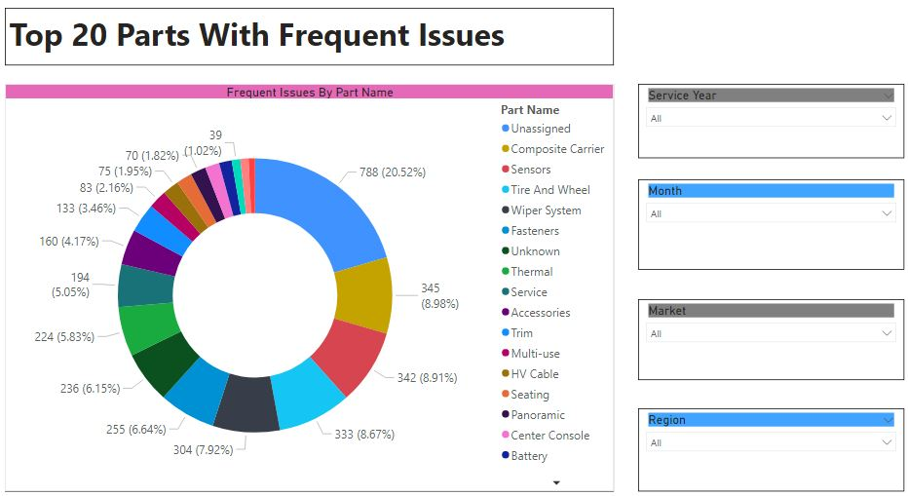
REPORT

Slide 25
Issue Log
Transformation in WeekDayWorkHours is quite complex. We are still working on a solution for this.
Some datetime data type for all dates are changed to varchar(20) for data transformations.
Bit data type for all flag values are changed to varchar(10) for data transformations.

Slide 26
Assumption Log
Users means Employees in table data
VOR field in table OrderJob refers to Vehicle Off Road Vehicle which is critical symptom
Enabled field in all table refers whether the record is active or not
IsCPO field in Orders table refers to Certified Pre Owned car
There are no derived dimensions in the dim tables
Certain data type changes in columns are acceptable

Slide 27
Thank You

